Slide 1
Network Security

Slide 2
Contents
Introduction
Cryptography
Symmetric-Key Algorithms
Public-Key Algorithms
Digital Signatures
Management of Public Keys
Communication Security
Authentication Protocols

Slide 3
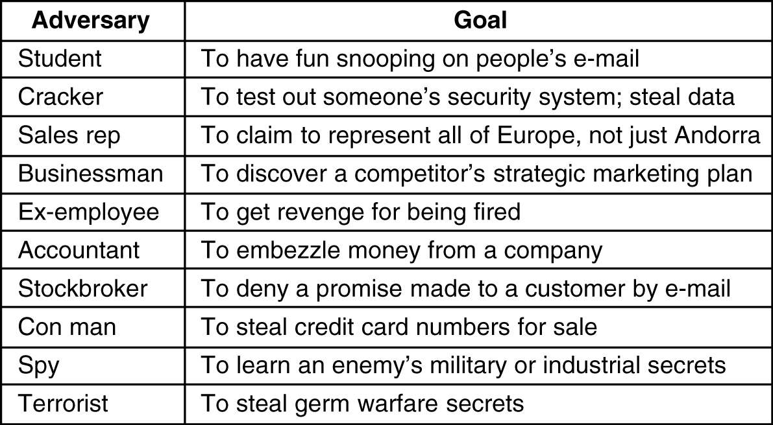
Need for Security
Some people who cause security problems and why

Slide 4
Introduction
Network security problems can be divided roughly into four closely intertwined areas: secrecy, authentication, nonrepudiation, and integrity control.
  Secrecy, also called confidentiality, has to do with keeping information out of the hands of unauthorized users.
  Authentication deals with determining whom you are talking to before revealing sensitive information or entering into a business deal.
  Nonrepudiation deals with signatures: How do you prove that your customer really placed an electronic order for ten million left-handed doohickeys at 89 cents each when he later claims the price was 69 cents?
Where in the protocol stack network security belongs.
  In the physical layer,
  In the data link layer,
  In the network layer,
  In the transport layer,
  In the application layer

Slide 5
Cryptography
Introduction to Cryptography
Substitution Ciphers
Transposition Ciphers

Slide 6
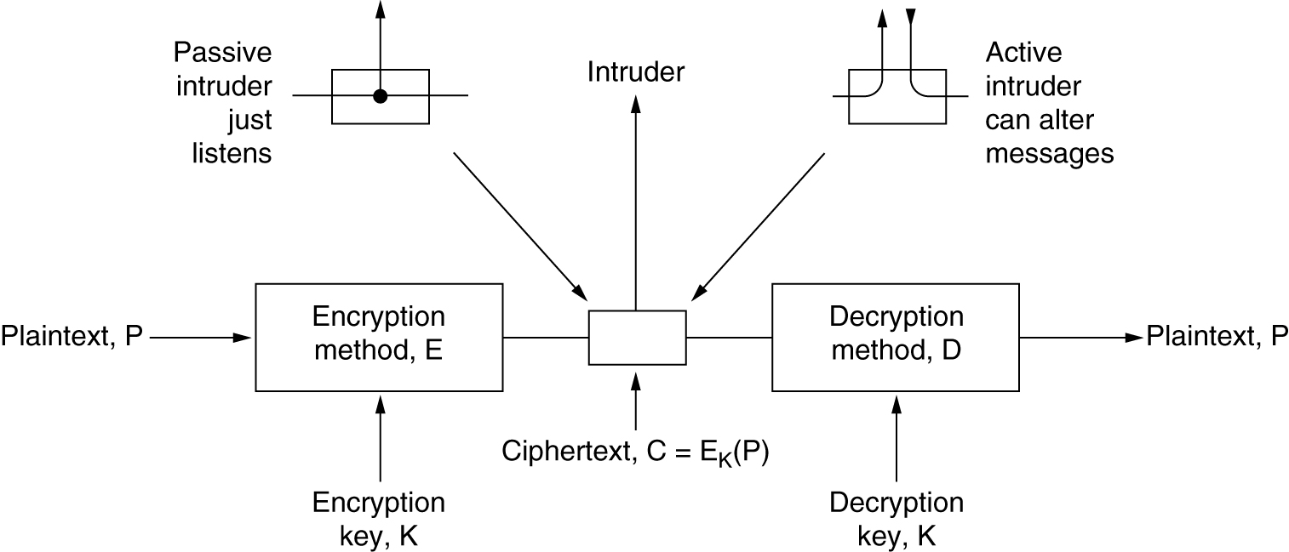
An Introduction to Cryptography
The encryption model (for a symmetric-key cipher)

Slide 7
Substitution Ciphers
In a substitution cipher each letter or group of letters is replaced by another letter or group of letters to disguise it.
plaintext: a b c d e f g h i j k l m n o p q r s t u v w x y z
ciphertext: Q W E R T Y U I O P A S D F G H J K L Z X C V B N M
For the key above, the plaintext attack
would be transformed into the ciphertext QZZQEA.

Slide 8
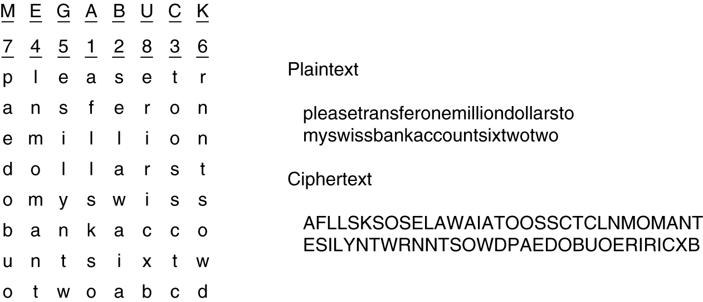
Transposition Ciphers
A transposition cipher.

Slide 9
Symmetric-Key Algorithms
Symmetric-key algorithms: used the same key for encryption and decryption
Cryptographic algorithms can be implemented in either hardware (for speed) or in software (for flexibility).
DES – The Data Encryption Standard

Slide 10
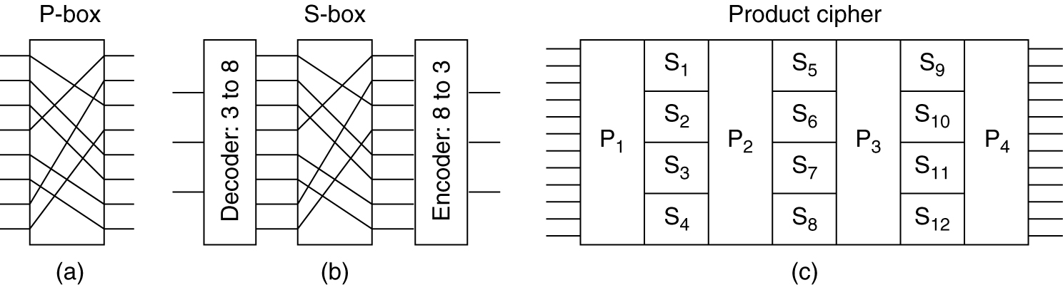
Product Ciphers
Basic elements of product ciphers. (a) P-box. (b) S-box. (c) Product.
P-box can be made to perform any transposition
Substitutions are performed by S-boxes

Slide 11
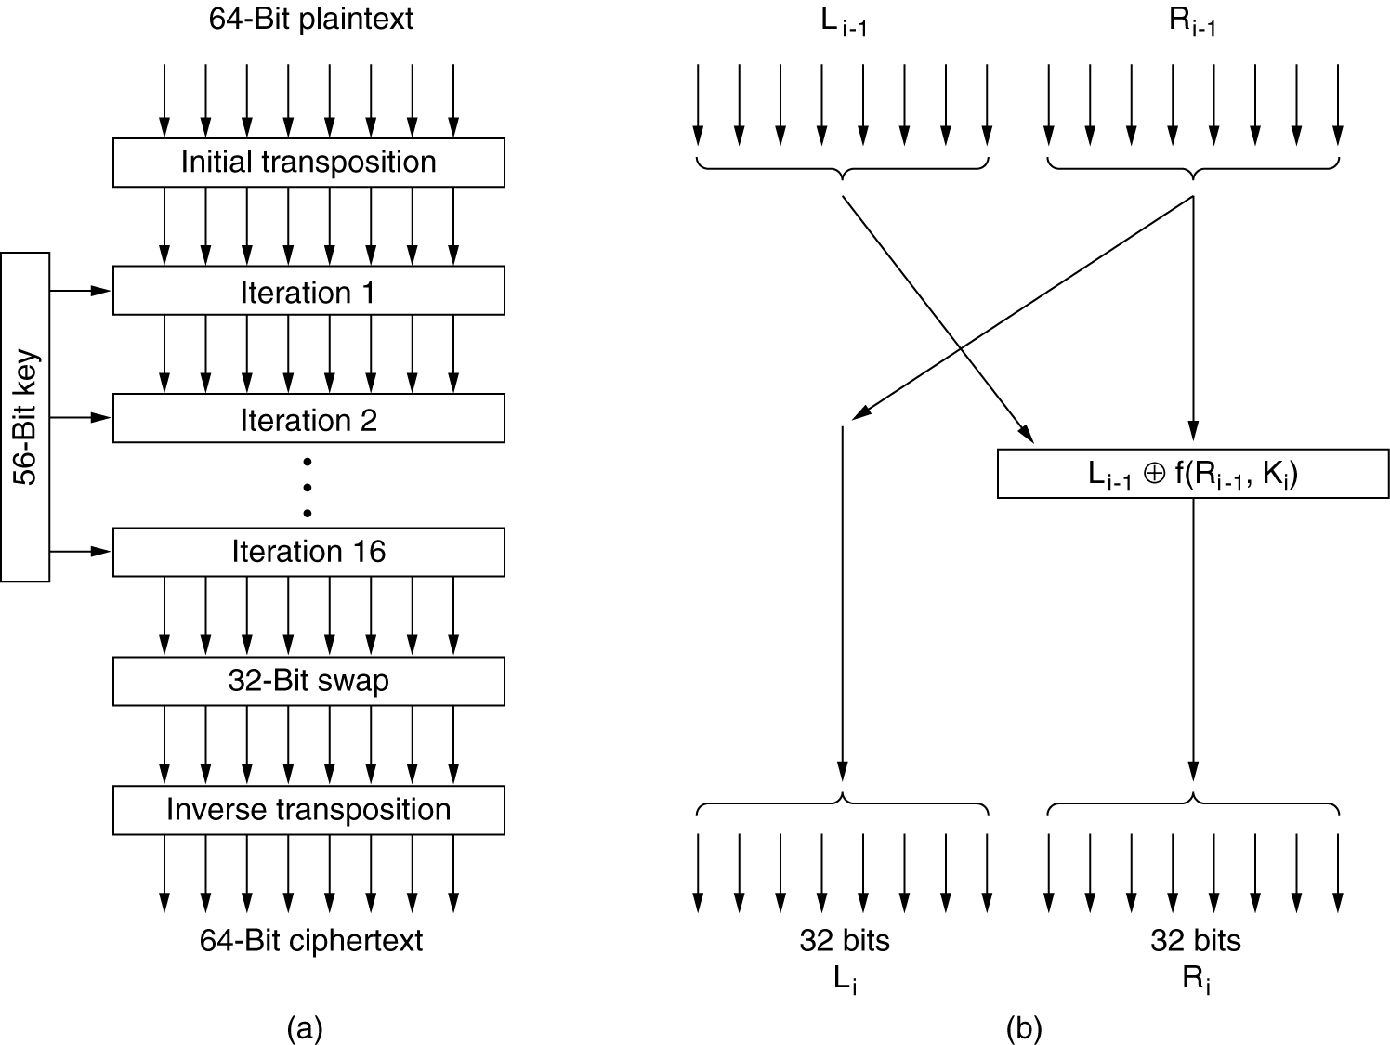
Data Encryption Standard
The data encryption standard. (a) General outline.
(b) Detail of one iteration. The circled + means exclusive OR.

Slide 12
Public-Key Algorithms
A radically new kind of cryptosystem, one in which the encryption and decryption keys were different, and the decryption key could not feasibly be derived from the encryption key.
In this kind of cryptosystem, the (keyed) encryption algorithm, E, and the (keyed) decryption algorithm, D, had to meet three requirements. These requirements can be stated simply as follows:
  D(E(P)) = P
  It is exceedingly difficult to deduce D from E.
  E cannot be broken by a chosen plaintext attack.
The encryption algorithm and the key are made public, hence the name public-key cryptography.
Public-key cryptography requires each user to have two keys: a public key, used by the entire world for encrypting messages to be sent to that user, and a private key, which the user needs for decrypting messages.

Slide 13
RSA
One good public-Key algorithms was discovered by a group at M.I.T. (Rivest et al., 1978). It is known by the initials of the three discoverers (Rivest, Shamir, Adleman): RSA.
The RSA method is based on some principles from number theory.
How to use the method:
  Choose two large primes, p and q (typically 1024 bits).
  Compute n = p x q and z = (p - 1) x (q - 1).
  Choose a number relatively prime to z and call it d.
  Find e such that e x d = 1 mod z.
With these parameters computed in advance, we are ready to begin encryption.
  grouping the plaintext into blocks of k bits, where k is the largest integer for which 2^{k} < n is true.
  To encrypt a message, P, compute C = P^{e} (mod n). To decrypt C, compute P = C^{d} (mod n).

Slide 14
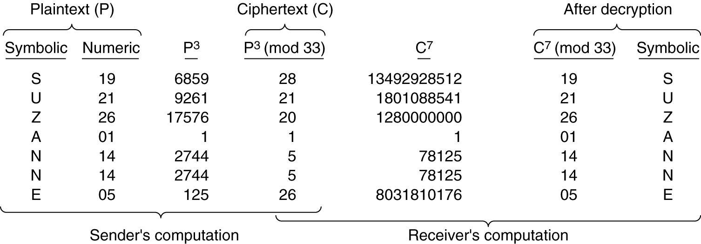
RSA
An example of the RSA algorithm
p = 3 and q = 11
n = 33 and z = 20
d = 7,
e = 3

Slide 15
Digital Signatures
The authenticity of many legal, financial, and other documents is determined by the presence or absence of an authorized handwritten signature.
For computerized message systems to replace the physical transport of paper and ink documents, a method must be found to allow documents to be signed in an unforgeable way.
Basically, what is needed is a system by which one party can send a signed message to another party in such a way that the following conditions hold:
  The receiver can verify the claimed identity of the sender.
  The sender cannot later repudiate the contents of the message.
  The receiver cannot possibly have concocted the message himself.

Slide 16
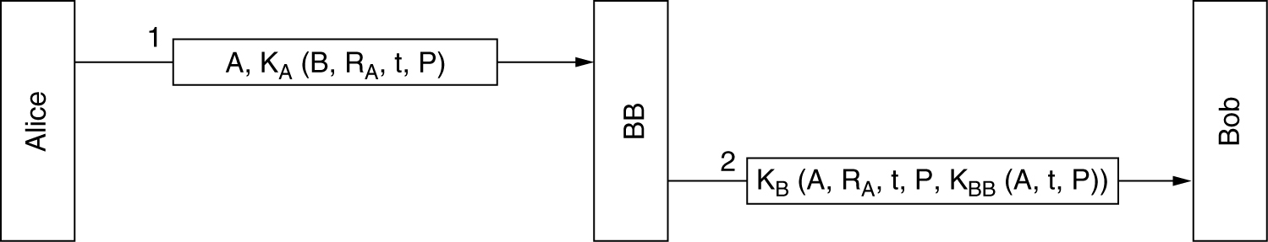
Symmetric-Key Signatures
One approach to digital signatures is to have a central authority that knows everything and whom everyone trusts.
Digital signatures with Big Brother

Slide 17
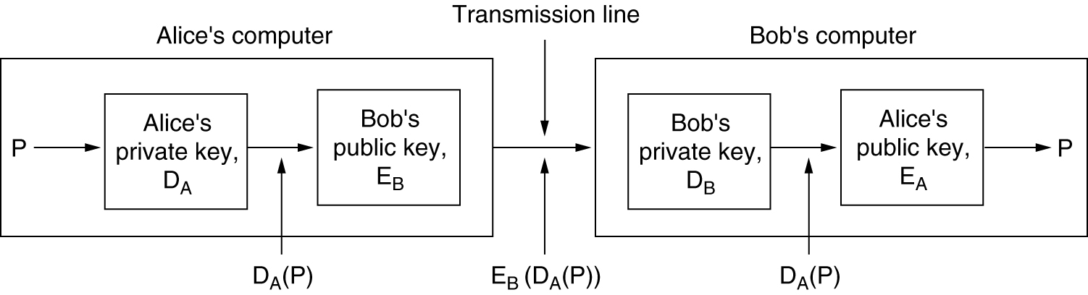
Public-Key Signatures
It would be nice if signing documents did not require a trusted authority.
the public-key encryption and decryption algorithms have the property that E(D(P)) = P in addition, of course, to the usual property that D(E(P)) = P.
Digital signatures using public-key cryptography

Slide 18
Message Digests
An authentication scheme that does not require encrypting the entire message
message digest: a one-way hash function, MD, that takes an arbitrarily long piece of plaintext and from it computes a fixed-length bit string.
message digest has four important properties
  Given P, it is easy to compute MD(P).
  Given MD(P), it is effectively impossible to find P
  Given P no one can find P' such that MD (P') = MD(P).
  A change to the input of even 1 bit produces a very different output.
Computing a message digest from a piece of plaintext is much faster than encrypting that plaintext with a public-key algorithm.
A variety of message digest functions have been proposed. The most widely used ones are MD5 (Rivest, 1992) and SHA-1 (NIST, 1993).
  SHA-1 (Secure Hash Algorithm )
  processes input data in 512-bit blocks, only unlike MD5, it generates a 160-bit message digest

Slide 19
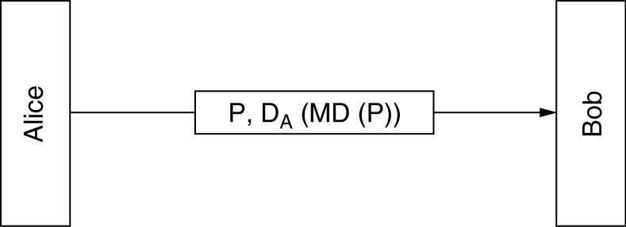
Message Digests
Digital signatures using message digests

Slide 20
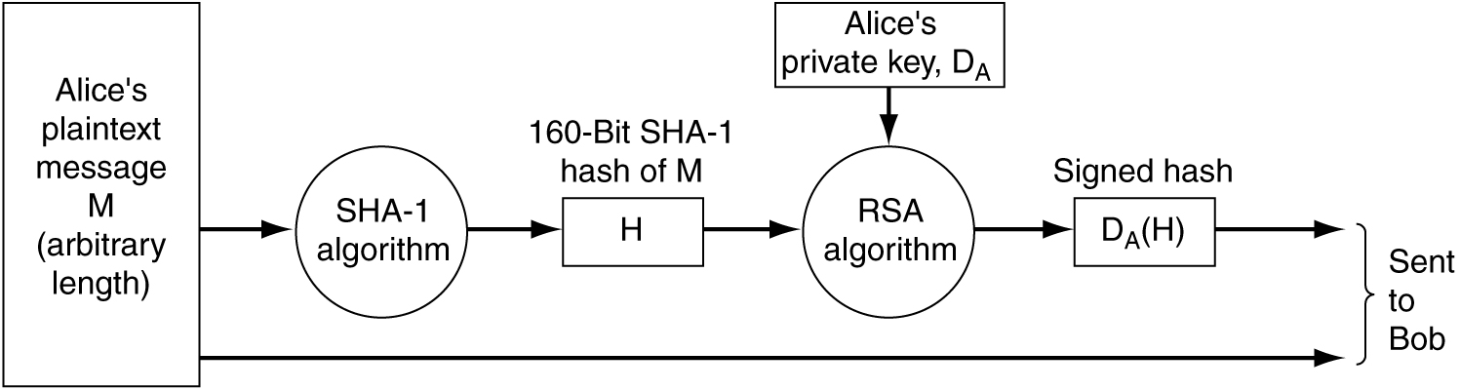
SHA-1
Use of SHA-1 and RSA for signing nonsecret messages.

Slide 21
Management of Public Keys
Certificates
X.509
Public Key Infrastructures

Slide 22
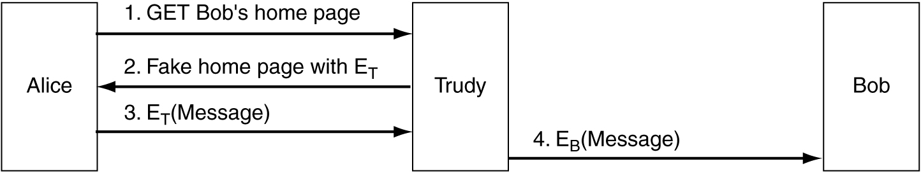
Problems with Public-Key Encryption
A way for Trudy to subvert public-key encryption
As a first attempt at distributing public keys securely, we could imagine a key distribution center available on-line 24 hours a day to provide public keys on demand.
An organization that certifies public keys is now called a CA (Certification Authority).

Slide 23
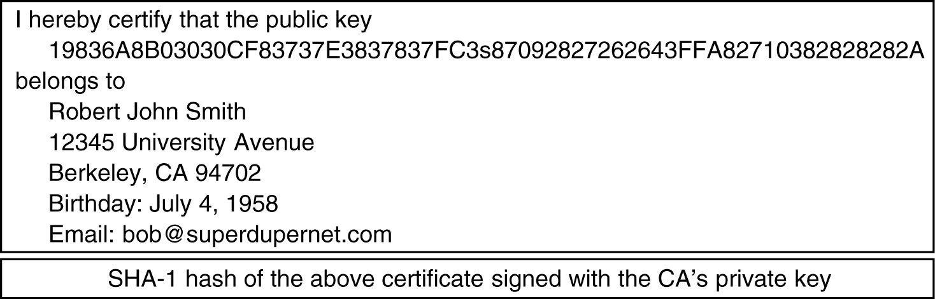
Certificates
A possible certificate and its signed hash.
The CA then issues a certificate similar to the one in Fig. 8-24 and signs its SHA-1 hash with the CA's private key.
This scheme does not require the CA to be on-line for verification

Slide 24
X.509
If everybody who wanted something signed went to the CA with a different kind of certificate, managing all the different formats would soon become a problem.
To solve this problem, a standard for certificates has been devised and approved by ITU.
The standard is called X.509 and is in widespread use on the Internet.
The IETF version of X.509 is described in RFC 3280.
X.509 is a way to describe certificates

Slide 25
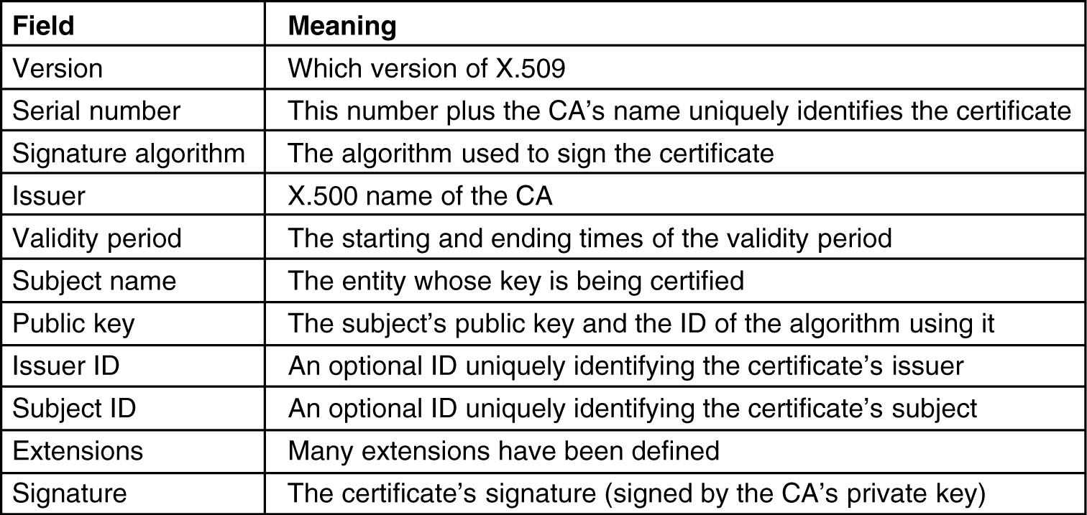
X.509
The basic fields of an X.509 certificate.
For example, if Bob works in the loan department of the Money Bank, his X.500 address might be:
/C=US/O=MoneyBank/OU=Loan/CN=Bob/

Slide 26
Public-Key Infrastructures
PKI (Public Key Infrastructure): for certifying public keys
A PKI has multiple components, including users, CAs, certificates, and directories. What the PKI does is provide a way of structuring these components and define standards for the various documents and protocols.

Slide 27
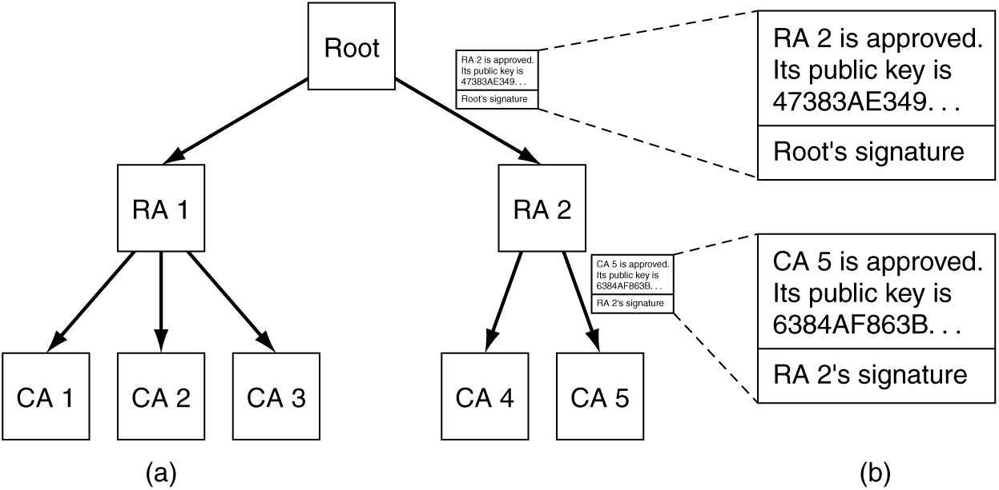
Public-Key Infrastructures
(a) A hierarchical PKI. (b) A chain of certificates.
RAs (Regional Authorities)
trust anchors

Slide 28
Communication Security
Communication security: how to get the bits secretly and without modification from source to destination and how to keep unwanted bits outside the door.
  IPsec (IP security)
  Firewalls

Slide 29
IPsec
The complete IPsec design is a framework for multiple services, algorithms and granularities.
The reason for multiple services is that not everyone wants to pay the price for having all the services all the time, so the services are available a la carte.
  The major services are secrecy, data integrity, and protection from replay attacks (intruder replays a conversation).
  All of these are based on symmetric-key cryptography because high performance is crucial.
The reason for having multiple algorithms is that an algorithm that is now thought to be secure may be broken in the future.
  By making IPsec algorithm-independent, the framework can survive even if some particular algorithm is later broken.
The reason for having multiple granularities is to make it possible to protect a single TCP connection, all traffic between a pair of hosts, or all traffic between a pair of secure routers, among other possibilities.

Slide 30
IPSec
Though it is in the IP layer, IPSec is connection oriented.
  to have any security, a key must be established and used for some period of time—in essence, a kind of connection.
  A ''connection'' in the context of IPsec is called an SA (security association).
  An SA is a simplex connection between two end points and has a security identifier associated with it.
  If secure traffic is needed in both directions, two security associations are required.
  Security identifiers are carried in packets traveling on these secure connections and are used to look up keys and other relevant information when a secure packet arrives.
IPsec has two principal parts.
  The first part describes two new headers that can be added to packets to carry the security identifier, integrity control data, and other information.
  The other part, ISAKMP (Internet Security Association and Key Management Protocol) deals with establishing keys.

Slide 31
IPSec
IPsec can be used in either of two modes.
  In transport mode: the IPsec header is inserted just after the IP header.
    The Protocol field in the IP header is changed to indicate that an IPsec header follows the normal IP header (before the TCP header).
    The IPsec header contains security information, primarily the SA identifier, a new sequence number, and possibly an integrity check of the payload.
  In tunnel mode: the entire IP packet, header and all, is encapsulated in the body of a new IP packet with a completely new IP header.
    Tunnel mode is useful when the tunnel ends at a location other than the final destination.
    In some cases, the end of the tunnel is a security gateway machine, for example, a company firewall.

Slide 32
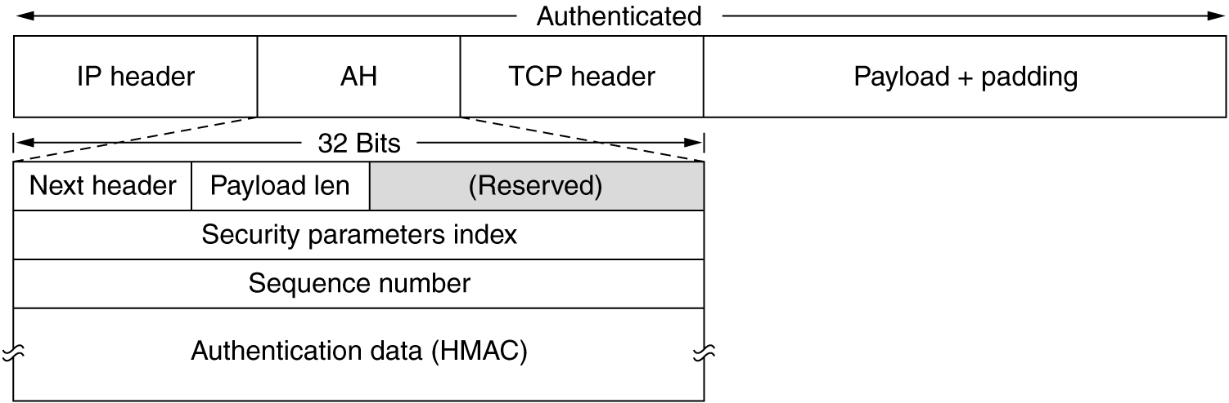
IPsec
The IPsec authentication header in transport mode for IPv4.

Slide 33
IPsec
AH header
  The Next header field is used to store the previous value that the IP Protocol field had before it was replaced with 51 to indicate that an AH header follows.
  The Payload length is the number of 32-bit words in the AH header minus 2.
  The Security parameters index is the connection identifier
  The Sequence number field is used to number all the packets sent on an SA.
  the Authentication data, which is a variable-length field that contains the payload's digital signature.
    When the SA is established, the two sides negotiate which signature algorithm they are going to use.
    Since IPsec is based on symmetric-key cryptography and the sender and receiver negotiate a shared key before setting up an SA, the shared key is used in the signature computation.
    The shared key is not transmitted, of course.

Slide 34
IPSec
The AH header does not allow encryption of the data, so it is mostly useful when integrity checking is needed but secrecy is not needed.
One noteworthy feature of AH is that the integrity check covers some of the fields in the IP header, namely, those that do not change as the packet moves from router to router.
  The Time to live field changes on each hop, for example, so it cannot be included in the integrity check.
  However, the IP source address is included in the check, making it impossible for an intruder to falsify the origin of a packet.

Slide 35
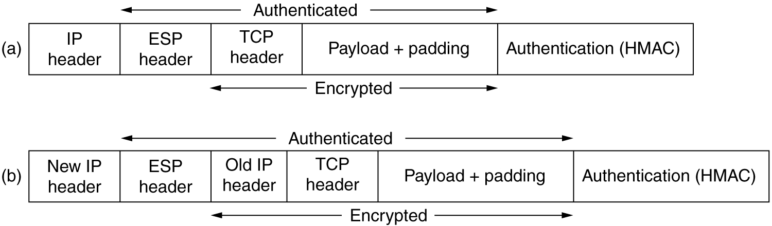
IPsec
(a) ESP in transport mode. (b) ESP in tunnel mode.

Slide 36
Firewalls
the danger of information leaking out
a danger of information leaking in
  In particular, viruses, worms, and other digital pests can breach security, destroy valuable data, and waste large amounts of administrators' time trying to clean up the mess they leave.
Consequently, mechanisms are needed to keep ''good'' bits in and ''bad'' bits out.
Firewalls: a company can have many LANs connected in arbitrary ways, but all traffic to or from the company is forced through an electronic drawbridge (firewall), as shown in Fig. 8-29

Slide 37
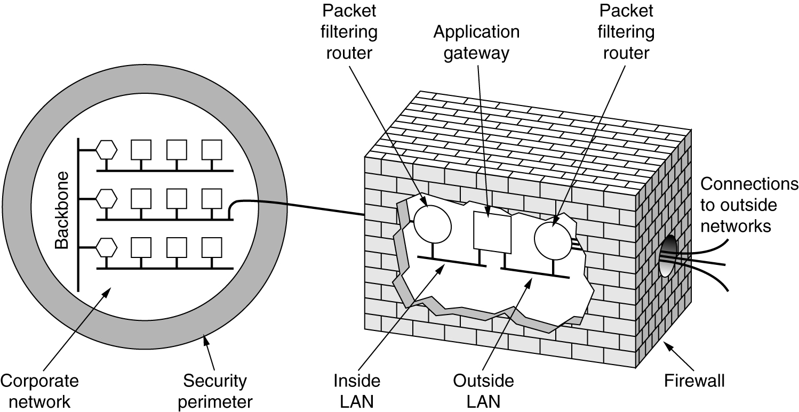
Firewalls
A firewall consisting of two packet filters and an application gateway

Slide 38
Firewalls - Packet filters
Every packet must transit two filters and an application gateway to go in or out.
  Packets meeting some criterion are forwarded normally.
Packet filters are typically driven by tables configured by the system administrator.
  These tables list sources and destinations that are acceptable, sources and destinations that are blocked, and default rules about what to do with packets coming from or going to other machines.
Blocking outgoing packets is trickier
  some sites not stick to the standard port numbering conventions
  for some important services, such as FTP (File Transfer Protocol), port numbers are assigned dynamically
  blocking UDP packets is even harder

Slide 39
Firewalls - Application Gateway
The application gateway operates at the application level.
  the gateway decides whether to transmit or discard the message based on header fields, message size, or even the content.

Slide 40
Firewalls
problems still exist
  an intruder outside the firewall can put in false source addresses to bypass this check
  insider ships out secret documents by encrypting them or even photographing them and shipping the photos as JPEG files, which bypasses any word filters.
  a whole other class of attacks that firewalls cannot deal with: DoS (Denial of Service) attacks, DDoS (Distributed Denial of Service) attack

Slide 41
Authentication Protocols
Authentication deals with the question of whether you are actually communicating with a specific process.
Authorization is concerned with what that process is permitted to do.
The general model that all authentication protocols use
  public-key cryptography is widely used for the authentication protocols themselves and for establishing the session key
  a secret session key for use in the upcoming conversation
Authentication protocols
  Authentication Based on a Shared Secret Key
  Establishing a Shared Key: Diffie-Hellman
  Authentication Using a Key Distribution Center
  Authentication Using Kerberos
  Authentication Using Public-Key Cryptography

Slide 42
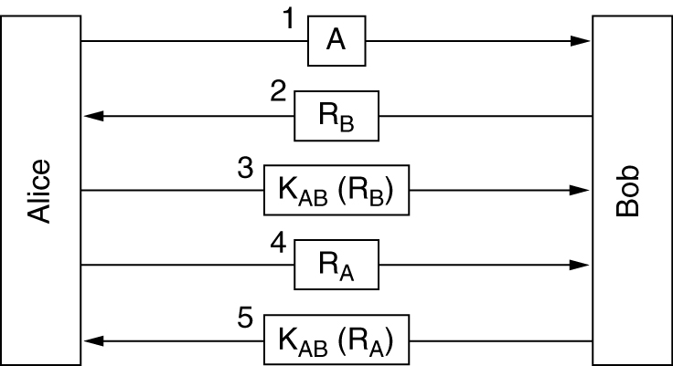
Authentication Based on a Shared Secret Key
Figure 8-32 Two-way authentication using a challenge-response protocol
assume that Alice and Bob already share a secret key, K_{AB}

Slide 43
Authentication Based on a Shared Secret Key
assume that Alice and Bob already share a secret key, K_{AB}
This protocol is based on a principle found in many authentication protocols:
  one party sends a random number to the other, who then transforms it in a special way and then returns the result.
  Such protocols are called challenge-response protocols.
notation used:
  A, B are the identities of Alice and Bob
  R_{i}'s are the challenges, where the subscript identifies the challenger.
  K_{i} are keys, where i indicates the owner
  K_{S} is the session key

Slide 44
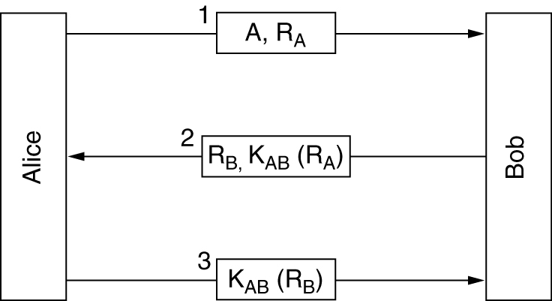
Authentication Based on a Shared Secret Key (2)
A shortened two-way authentication protocol
Under certain circumstances, Trudy can defeat this protocol by using what is known as a reflection attack. In particular, Trudy can break it if it is possible to open multiple sessions with Bob at once.

Slide 45
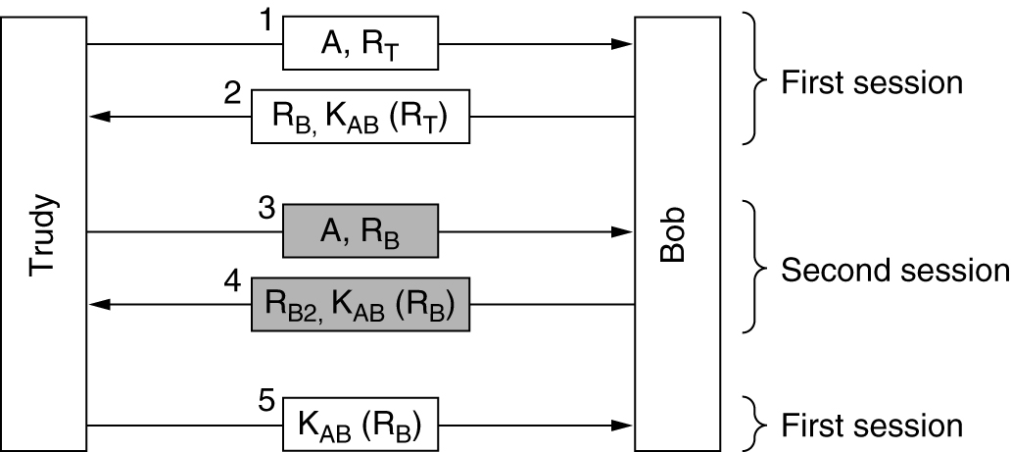
Authentication Based on a Shared Secret Key (3)
The reflection attack

Slide 46
Authentication Based on a Shared Secret Key (4)
general rules helpful:
  Have the initiator prove who she is before the responder has to.
  Have the initiator and responder use different keys for proof, even if this means having two shared keys, K_{AB} and K'_{AB}
  Have the initiator and responder draw their challenges from different sets.
  Make the protocol resistant to attacks involving a second parallel session in which information obtained in one session is used in a different one.

Slide 47
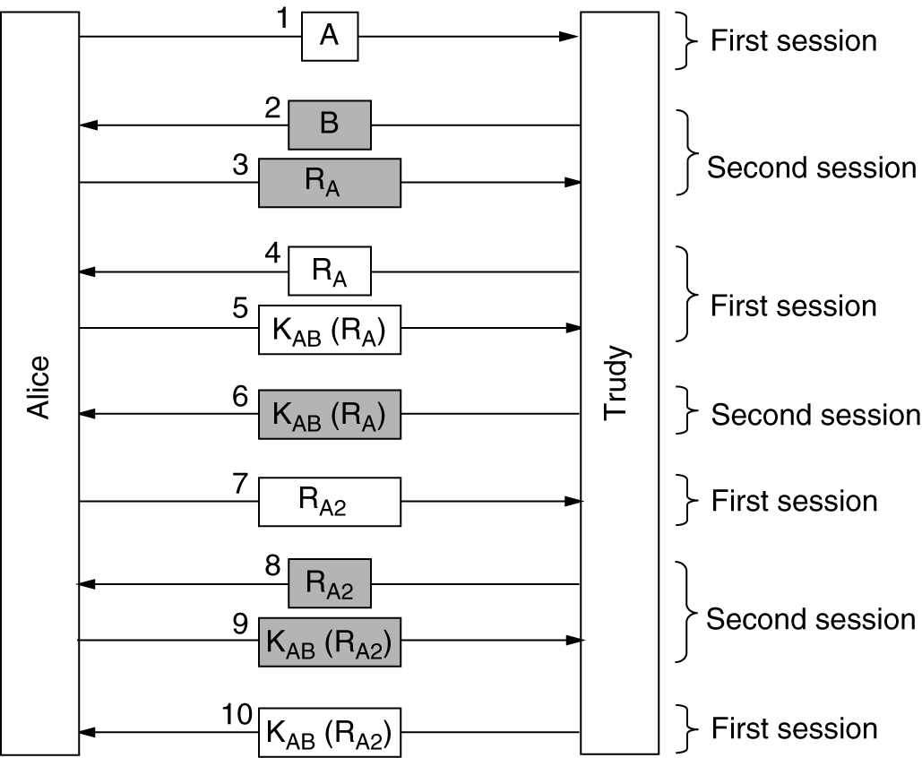
Authentication Based on a Shared Secret Key (5)
A reflection attack on the protocol of Fig. 8-32

Slide 48
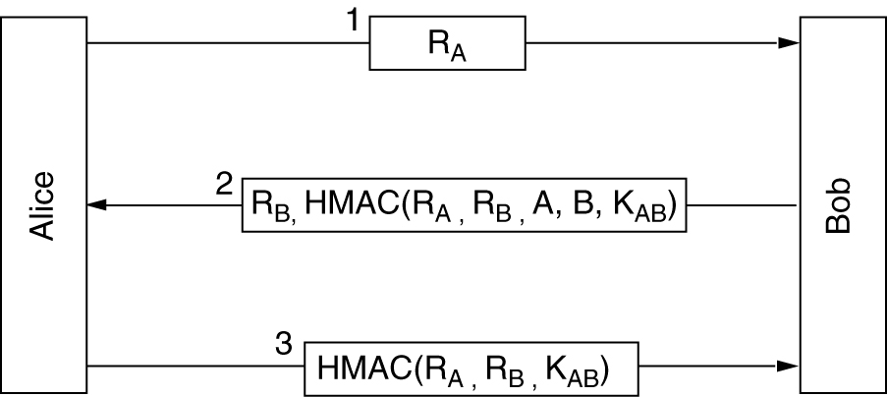
Authentication Based on a Shared Secret Key (6)
Authentication using HMACs

Slide 49
Summary
Network security problems:
  secrecy, authentication, nonrepudiation, and integrity control
Cryptography
  Substitution Ciphers, Transposition Ciphers
Symmetric-Key Algorithms
  same key for encryption and decryption
Public-Key Algorithms
  the encryption and decryption keys were different,
  the decryption key could not feasibly be derived from the encryption key
Digital Signatures
  Symmetric-Key Signatures, Public-Key Signatures, Message Digests
Management of Public Keys
  Certificates, X.509, Public Key Infrastructures
Communication Security
  IPsec, Firewalls
Authentication Protocols
Notes:
总结本讲内容

